Slide 1
Finding Frequent Itemsets: Improvements to A-Priori
Park-Chen-Yu Algorithm
Multistage Algorithm
Multi-Hash Algorithm
Approximate Algorithms
Professor Wei-Min Shen
University of Southern California
Thanks for source slides and material to:
J. Leskovec, A. Rajaraman, J. Ullman: Mining of Massive Datasets
http://www.mmds.org

Slide 2
Park-Chen-Yu (PCY) Algorithm

Slide 3
Can we do better than A-Priori?
A Priori Memory Usage:
Item counts
Frequent items
Old item #s
Counts of pairs of frequent items
Counts of pairs of frequent items
Main memory
Pass 1
Pass 2

Slide 4
PCY Algorithm – An Application of Hash-Filtering
During Pass 1 of A-priori, most memory is idle
Use that memory to keep counts of buckets into which pairs of items are hashed
A Priori Memory Usage:
Item counts
Frequent items
Old item #s
Counts of pairs of frequent items
Counts of pairs of frequent items
Main memory
Pass 1
Pass 2

Slide 5
PCY (Park-Chen-Yu) Algorithm
Observation: In pass 1 of A-Priori, most memory is idle
We store only individual item counts
Can we use the idle memory to reduce memory required in pass 2?
Pass 1 of PCY: In addition to item counts, maintain a hash table with as many buckets as fit in memory
Keep a count for each bucket into which pairs of items are hashed
For each bucket just keep the count, not the actual pairs that hash to the bucket!
// not “baskets”

Slide 6
PCY Algorithm – First Pass
FOR (each basket) :
FOR (each item in the basket) :
add 1 to item’s count;
FOR (each pair of items) :
hash the pair to a bucket;
add 1 to the count for that bucket;
A few things to note:
Pairs of items need to be generated from the input file; they are not present in the file
We are not just interested in the presence of a pair, but we need to see whether it is present at least s (support) times
New in PCY

Slide 7
Main-Memory: Picture of PCY Pass 1
Hash
table
Item counts
Hash table for pairs
(buckets)
Main memory
Pass 1
Notes:
Why hash table takes full space?
We want to make it as large as possible.
Why hash table bigger than bitmap?
Hash table contains counts

Slide 8
Observations about Buckets
A bucket is frequent if its count is at least the support threshold s
Observation: If a bucket contains a frequent pair, then the bucket is surely frequent (why?)
A bucket may contain more than one pairs (same hash), thus, a bucket may still be frequent, but the pairs in that bucket may not be “truly frequent”
So, we cannot use the hash to eliminate any member (pair) of a “frequent” bucket
But, for a bucket with total count less than s, then none of its pairs can be frequent (why?)
Pairs that hash to this bucket can be eliminated as candidates (even if the pair consists of 2 frequent items)
Pass 2: Only count pairs that hash to frequent buckets

Slide 9
PCY Algorithm – Between Passes
Replace the buckets by a bit-vector:
1 means the bucket count exceeded the support s (call it a frequent bucket); 0 means it did not
4-byte integer counts are replaced by bits, so the bit-vector requires 1/32 of memory
As for A Priori, decide which items are frequent in first pass and list them for the second pass

Slide 10
Main-Memory: Picture of PCY
Hash
table
Frequent items
Item counts
Bitmap
Hash table for pairs
Main memory
Counts of
candidate
pairs
Pass 1
Pass 2
Notes:
W1.2

Slide 11
PCY Algorithm – Pass 2
Count all pairs {i, j} that meet the conditions for being a candidate pair:
Both i and j are frequent items
The pair {i, j} has been hashed into a bucket whose bit in the bit vector is 1 (i.e., a frequent bucket)
Both conditions are necessary for the pair to have a chance of being frequent

Slide 12
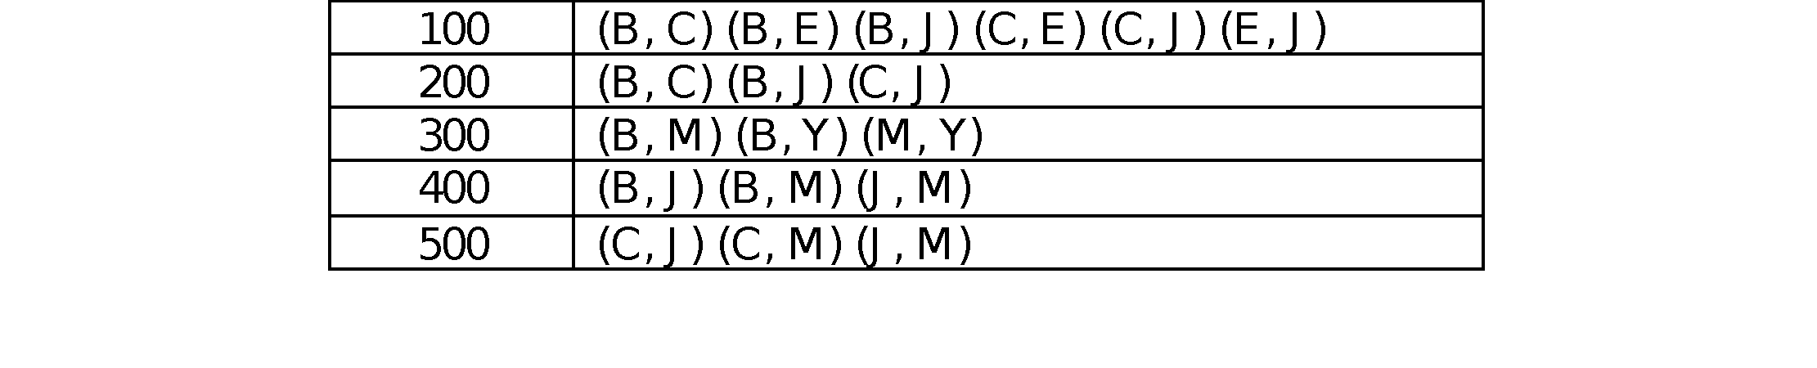

Hashing Example
Consider a basket database in the first table below
All itemsets of size 1 determined to be frequent on previous pass
The second table below shows all possible 2-itemsets for each basket

Slide 13
Example Hash Function
For each pair, a numeric value is obtained by first representing B by 1, C by 2, E 3, J 4, M 5 and Y 6.
Now each pair can be represented by a two digit number
(B, E) by 13 (C, M) by 25
Use hash function on these numbers: e.g., number modulo 8
Hashed value is the bucket number
Keep count of the number of pairs hashed to each bucket
Buckets that have a count above the support value are frequent buckets
Set corresponding bit in bitmap to 1; otherwise, bit is 0
All pairs in rows that have zero bit are removed as candidates

Slide 14
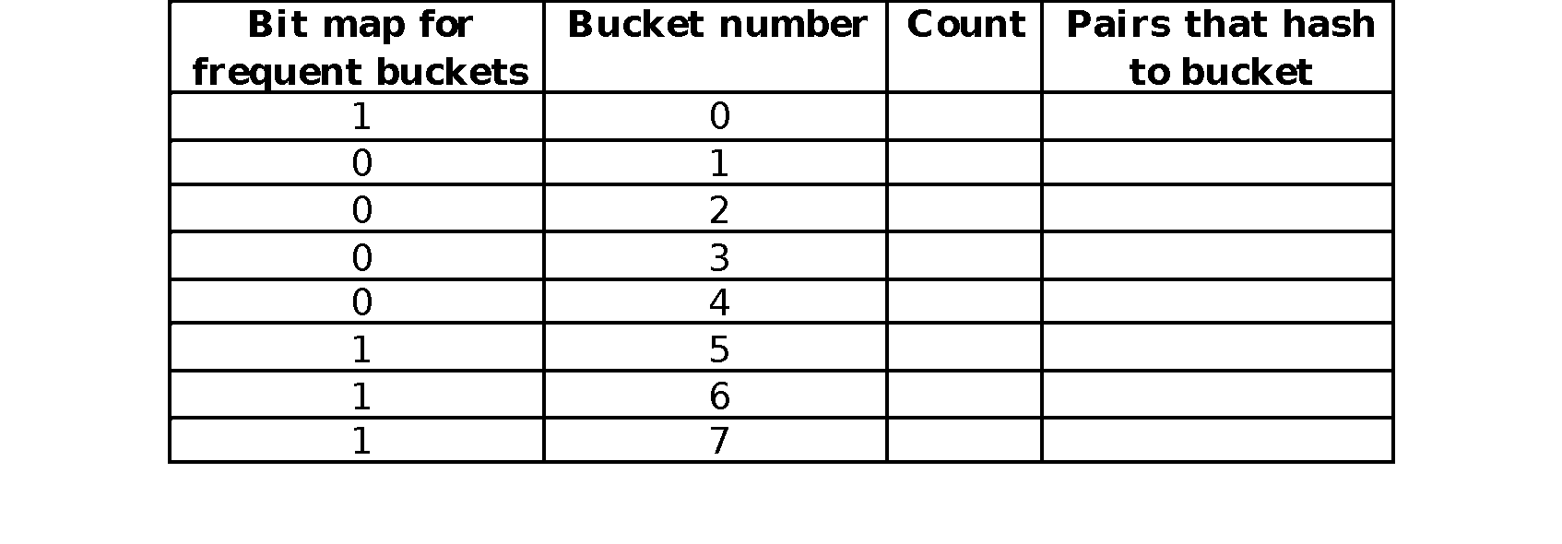
Hashing Example Bucket support Threshold = 3
The possible pairs:
(B,C) -> 12, 12%8 = 4; (B,E) -> 13, 13%8 = 5; (C, J) -> 24, 24%8 = 0
Mapping table
B | 1
C | 2
E | 3
J | 4
M | 5
Y | 6

Slide 15
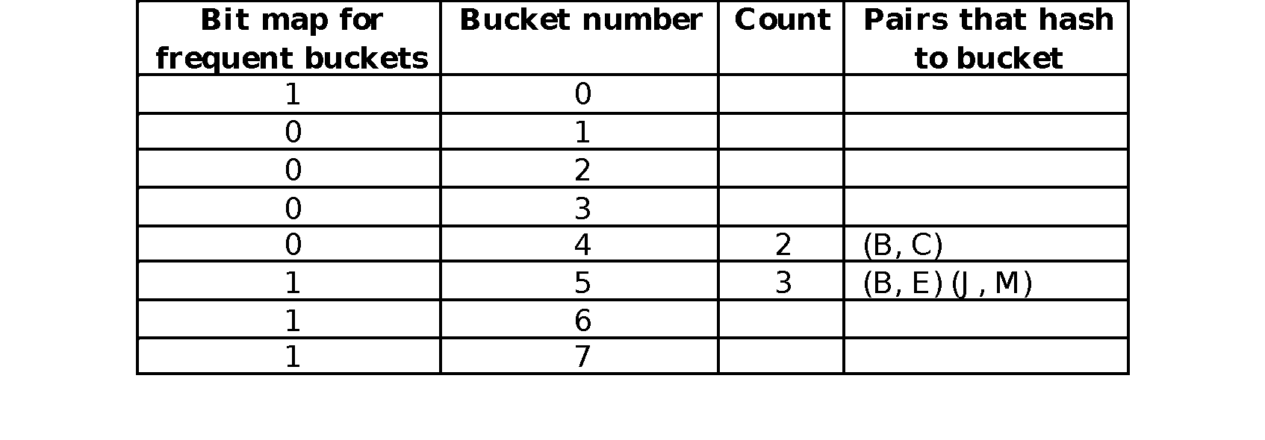
Hashing Example Bucket support Threshold = 3
The possible pairs:
(B,C) -> 12, 12%8 = 4; (B,E) -> 13, 13%8 = 5; (C, J) -> 24, 24%8 = 0
Mapping table
these pairs
are not
remembered
B | 1
C | 2
E | 3
J | 4
M | 5
Y | 6
Bucket 5 is frequent. Are any of the pairs that hash to the bucket frequent?
Does Pass 1 of PCY remember which pairs contributed to the bucket? No

Slide 16
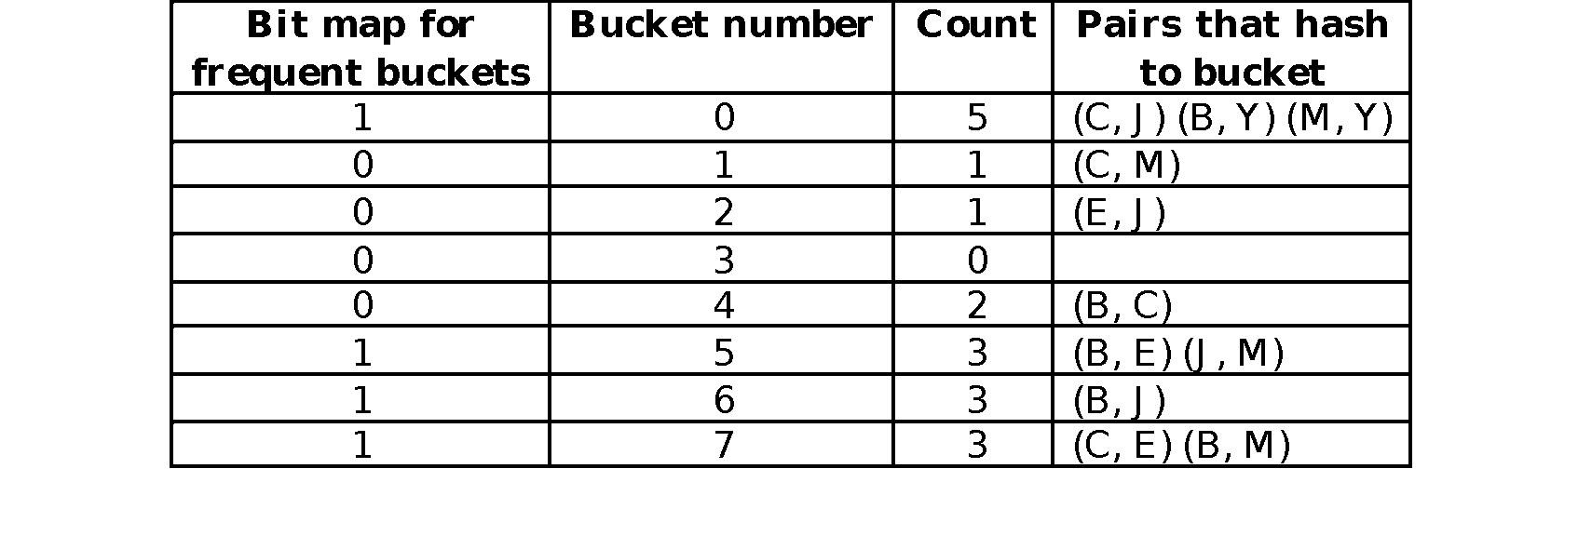
Hashing Example Bucket support Threshold = 3
The possible pairs:
(B,C) -> 12, 12%8 = 4; (B,E) -> 13, 13%8 = 5; (C, J) -> 24, 24%8 = 0
Mapping table
these pairs
are not
remembered
B | 1
C | 2
E | 3
J | 4
M | 5
Y | 6
At end of Pass 1, know only which buckets (not pairs) are frequent
All pairs that hash to those buckets are candidates and will be counted

Slide 17
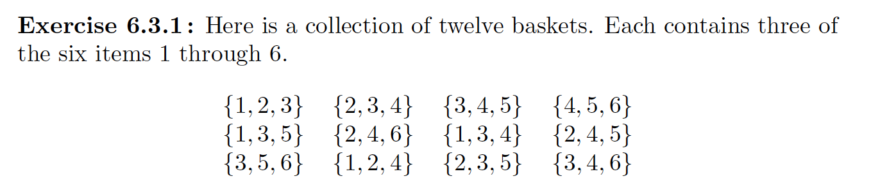
Another Hashing Example (Try yourself)
Hash functions: i+j mod 9
Notes:
201601W2.1

Slide 18
Main-Memory Details
Buckets require a few bytes each
Note: we do not have to count past s
#buckets is O(main-memory size)
On second pass, a table of (item, item, count) triples is essential
We cannot use triangular matrix approach: why? Why
Thus, hash table must eliminate approx. 2/3 of the candidate pairs for PCY to beat A-Priori
Notes:
Why? While we were able to use the triangular-matrix
method on the second pass of A-Priori if we wished, because the frequent items
could be renumbered from 1 to some m, we cannot do so for PCY. The reason
is that the pairs of frequent items that PCY lets us avoid counting are placed
randomly within the triangular matrix; they are the pairs that happen to hash
to an infrequent bucket on the ﬁrst pass. There is no known way of compacting
the matrix to avoid leaving space for the uncounted pairs.
2018 01 w1.2

Slide 19
Why Can’t We use a Triangular Matrix on Phase 2 of PCY?
Recall: in A-Priori, the frequent items could be renumbered in Pass 2 from 1 to m
Can’t do that for PCY
Pairs of frequent items that PCY lets us avoid counting are placed randomly within the triangular matrix
Pairs that happen to hash to an infrequent bucket on first pass
No known way of compacting matrix to avoid leaving space for uncounted pairs
Must use the triples method

Slide 20
Hashing (summary)
In PCY algorithm, when generating L₁, the set of frequent single items, the algorithm also:
generates all possible pairs for each basket
hashes them to buckets
keeps a count for each hash bucket
identifies frequent buckets (count >= s)
Hash
table
Frequent items
Item counts
Recall:
Main-Memory Picture of PCY
Hash table for pairs
Bitmap
Main memory
Counts of
candidate
pairs
Pass 1
Pass 2

Slide 21
The Goal of Hashing: Reduce the number of candidate pairs
Goal: reduce the size of candidate set C₂
Only have to count candidate pairs (not all pairs)
Candidate pairs are that hash to a frequent bucket
Essential that the hash table is large enough so that collisions are few
Collisions result in loss of effectiveness of the hash table
In our example, three frequent buckets had collisions
Must count all those pairs to determine which are truly frequent

Slide 22
Multi-Stage Algorithm
Notes:
2016.03 w2.1

Slide 23
Refinement: Multistage Algorithm
Limit the number of candidates to be counted
Remember: Memory is the bottleneck
Still need to generate all the itemsets but we only want to count/keep track of the ones that are frequent
Key idea: After Pass 1 of PCY, rehash only those pairs that qualify for Pass 2 of PCY
i and j are frequent, and
{i, j} hashes to a frequent bucket from Pass 1
On middle pass, fewer pairs contribute to buckets, so fewer false positives
Requires 3 passes over the data

Slide 24
Main-Memory: Multistage
First
hash table
Item counts
Freq. items
Freq. items
Need this?
First hash table
1st filter
Bitmap 1
Bitmap 1
Main memory
Second hash table
2nd filer
Bitmap 2
Counts of
candidate
pairs
Pass 1
Pass 2
Pass 3
Hash pairs {i,j} into Hash2 iff:
i,j are frequent; {i,j} belongs to a
freq. bucket in B1
Count pairs {i,j} iff:
i,j are frequent, {i,j} hashes to
freq. bucket in B1
{i,j} hashes to
freq. bucket in B2
Count items
Hash pairs {i,j}
Notes:
Look at both bitmaps to eliminate maximum number of candidates that hash to frequent bucket.
This post is regarding why it is necessary to check if a pair hashed to a frequent bucket in pass 1 and not just in pass 2.
It is true that a pair which hashes to an infrequent bucket in pass 1 would not be hashed in the 2nd hash table in pass 2. Even though this stands, while looking at the 2nd hash table we won't be able to figure out if the pair in question is actually attributing to the count of the bucket to which it may have hashed (had it belonged to a frequent bucket in stage 1). While checking in the 2nd hash table for a pair (i,j), we would first figure out the bucket to which it would have hashed. If this bucket is frequent, we cannot figure out whether the (i,j) actually attributed to the count of the bucket. This can only be done by checking in the 1st hash table.

Slide 25
Multistage – Pass 3
Count only those pairs {i, j} that satisfy these candidate pair conditions:
Both i and j are frequent items
Using the first hash function, the pair hashes to a bucket whose bit in the first bit-vector is 1
Using the second hash function, the pair hashes to a bucket whose bit in the second bit-vector is 1

Slide 26
Important Points
The two hash functions have to be independent
We need to check both hashes on the third pass
If not, we would end up counting pairs of frequent items that hashed first to an infrequent bucket but happened to hash second to a frequent bucket
Would be a false positive
Notes:
Because the hash function could hash infrequent item pairs into frequent bucket
For example, a second hash function where i+j = odd will hash every i+j = odd to the first bucket (frequent) but (1,2) might not be frequent since the first hash function is j = odd and first bucket is frequent

Slide 27
Multi-stage Example bucket support threshold = 3
Try the multistage algorithm:
1st Hash function: i+j mod 8
2nd Hash function: i+j mod 5
??? (you fill in)
2nd hash
1st hash
These paris are
not remembered
Notes:
i j mod 11 cnt 1 2 2 2 1 3 3 3 1 4 4 2 1 5 5 1 1 6 6 0 2 3 6 3 2 4 8 3 2 5 10 2 2 6 1 1 3 4 1 3 3 5 4 2 3 6 7 2 4 5 9 3 4 6 2 3 5 6 8 2

Slide 28
Key Observation
Can insert any number of hash passes between first and last stage
Each one uses an independent hash function
Eventually, all memory would be consumed by bitmaps, no memory left for counts
Cost is another pass of reading the input data
The truly frequent pairs will always hash to a frequent bucket
So we will count the frequent pairs no matter how many hash functions we use

Slide 29
Multi-Hash Algorithm
Thanks for source slides and material to:
J. Leskovec, A. Rajaraman, J. Ullman: Mining of Massive Datasets
http://www.mmds.org

Slide 30
Refinement: Multihash
Key idea: Use several independent hash tables on the first pass
Risk: Halving the number of buckets doubles the average count
We have to be sure most buckets will still not reach count s
If so, we can get a benefit like multistage, but in only 2 passes

Slide 31
Main-Memory: Multihash
First hash
table
Second
hash table
Item counts
Freq. items
First hash table
Bitmap 1
Main memory
Bitmap 2
Counts of
candidate
pairs
Counts of
candidate
pairs
Second hash table
Pass 1
Pass 2

Slide 32
Multihash – Pass 2
Same condition as Multistage but checked in second pass
Count only those pairs {i, j} that satisfy these candidate pair conditions:
Both i and j are frequent items
Using the first hash function, the pair hashes to a bucket whose bit in the first bit-vector is 1
Using the second hash function, the pair hashes to a bucket whose bit in the second bit-vector is 1

Slide 33
Example
Try multi-hash algorithm:
1st Hash function: i+j mod 5
2nd Hash function: i+j mod 4
Notes:
i j mod 11 cnt 1 2 2 2 1 3 3 3 1 4 4 2 1 5 5 1 1 6 6 0 2 3 6 3 2 4 8 3 2 5 10 2 2 6 1 1 3 4 1 3 3 5 4 2 3 6 7 2 4 5 9 3 4 6 2 3 5 6 8 2

Slide 34
PCY: Extensions
Either multistage or multihash can use more than two hash functions
In multistage, there is a point of diminishing returns, since the bit-vectors eventually consume all of main memory
For multihash, the bit-vectors occupy exactly what one PCY bitmap does, but too many hash functions makes all counts > s
Notes:
W2.1

Slide 35
Finding Frequent Itemsets: Limited Pass Algorithms
Thanks for source slides and material to:
J. Leskovec, A. Rajaraman, J. Ullman: Mining of Massive Datasets
http://www.mmds.org

Slide 36
Limited Pass (Approximate) Algorithms
There are many applications where it is sufficient to find most but not all frequent itemsets
Algorithms to find these in at most 2 passes

Slide 37
Limited Pass Algorithms
Algorithms so far: compute exact collection of frequent itemsets of size k in k passes
A-Priori, PCY, Multistage, Multihash
Many applications where it is not essential to discover every frequent itemset
Sufficient to discover most of them
Next: algorithms that find all or most frequent itemsets using at most 2 passes over data
Sampling
SON
Toivonen’s Algorithm

Slide 38
Random Sampling of Input Data

Slide 39
Random Sampling
Take a random sample of the market baskets that fits in main memory
Leave enough space in memory for counts
Run a-priori or one of its improvements in main memory
For sets of all sizes, not just pairs
Don’t pay for disk I/O each time we increase the size of itemsets
Reduce support threshold proportionally to match the sample size
Copy of
sample
baskets
Main memory
Space
for
counts

Slide 40
How to Pick the Sample
The best way: read entire data set
For each basket, select that basket for the sample with probability p
For input data with m baskets
At end, will have a sample with size close to pm baskets
If file is part of distributed file system, can pick chunks at random for the sample

Slide 41
Support Threshold for Random Sampling
Adjust support threshold to a suitable, scaled-back number
To reflect the smaller number of baskets

Slide 42
Support Threshold for Random Sampling
Adjust support threshold to a suitable, scaled-back number
To reflect the smaller number of baskets
Example
If sample size is 1% or 1/100 of the baskets
Use s /100 as your support threshold
Itemset is frequent in the sample if it appears in at least s/100 of the baskets in the sample

Slide 43
Random Sampling: Not an exact algorithm
With a single pass, cannot guarantee:
That algorithm will produce all itemsets that are frequent in the whole dataset
False negative: itemset that is frequent in the whole but not in the sample

Slide 44
Random Sampling: Not an exact algorithm
With a single pass, cannot guarantee:
That algorithm will produce all itemsets that are frequent in the whole dataset
False negative: itemset that is frequent in the whole but not in the sample
That it will produce only itemsets that are frequent in the whole dataset
False positive: frequent in the sample but not in the whole
If the sample is large enough, there are unlikely to be serious errors

Slide 45
Random Sampling: Avoiding Errors
Improvement
Make a second pass through the full dataset
Count all itemsets that were identified as frequent in the sample
Verify that the candidate pairs are truly frequent in entire data set

Slide 46
Random Sampling: Avoiding Errors
Eliminate false positives
Make a second pass through the full dataset
Count all itemsets that were identified as frequent in the sample
Verify that the candidate pairs are truly frequent in entire data set
But this doesn’t eliminate false negatives
Itemsets that are frequent in the whole but not in the sample
Remain undiscovered
Reduce false negatives
Before, we used threshold ps where p is the sampling fraction
Reduce this threshold: e.g., 0.9ps
More itemsets of each size have to be counted
If memory allows: requires more space
Smaller threshold helps catch more truly frequent itemsets

Slide 47
Savasere, Omiecinski and Navathe (SON) Algorithm

Slide 48
SON Algorithm
Avoids false negatives and false positives
Requires two full passes over data

Slide 49
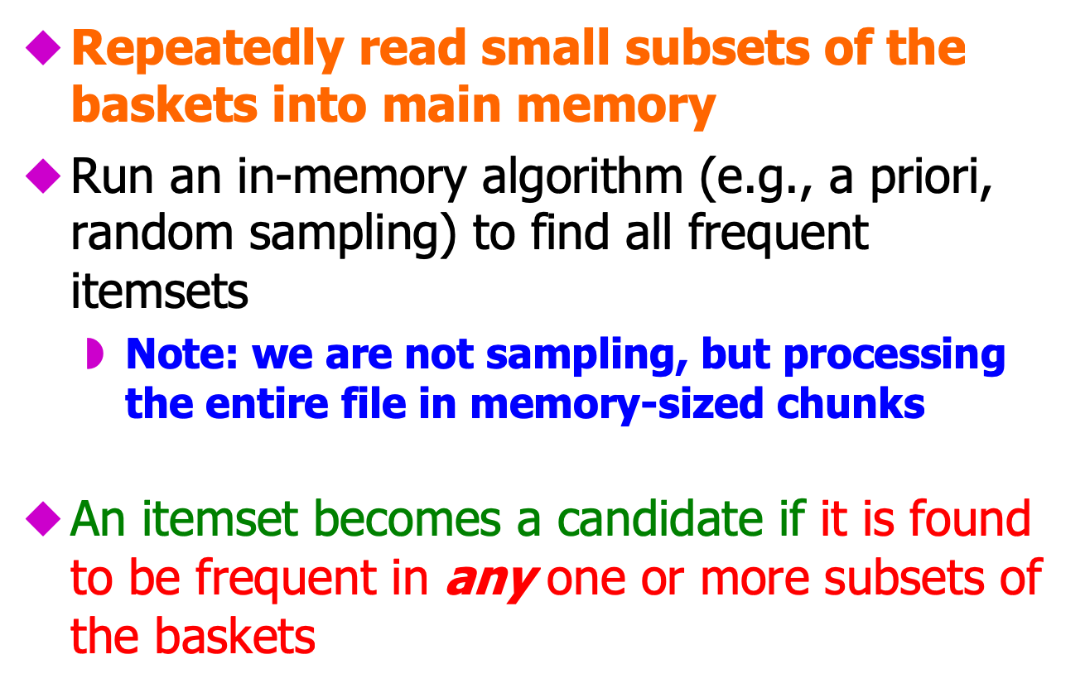
SON Algorithm – (1)

Slide 50
SON Algorithm – (2)
On a second pass, count all the candidate itemsets and determine which are frequent in the entire set

Slide 51
SON Algorithm – (2)
On a second pass, count all the candidate itemsets and determine which are frequent in the entire set
Key “monotonicity” idea: an itemset cannot be frequent in the entire set of baskets unless it is frequent in at least one subset

Slide 52
SON Algorithm – (2)
On a second pass, count all the candidate itemsets and determine which are frequent in the entire set
Key “monotonicity” idea: an itemset cannot be frequent in the entire set of baskets unless it is frequent in at least one subset
Subset or chunk contains fraction p of whole file
1/p chunks in file
If itemset is not frequent in any chunk, then support in each chunk is less than ps
Support in whole file is less than s: not frequent

Slide 53
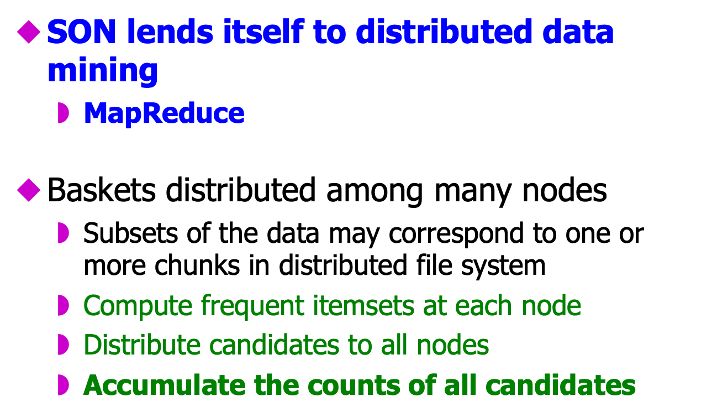
SON – Distributed Version

Slide 54
SON: Map/Reduce
Phase 1: Find candidate itemsets
Map?
Reduce?
Phase 2: Find true frequent itemsets
Map?
Reduce?

Slide 55
SON: Map/Reduce Phase 1: Find local candidate itemsets
Map
Input is a chunk/subset of all baskets; fraction p of total input file
Find itemsets frequent in that subset (e.g., using random sampling algorithm)
Use a scaled-down support threshold p*s
Output is set of key-value pairs (F, 1) where F is a frequent itemset from sample
Reduce
Each reduce task is assigned set of keys, which are itemsets
Produces keys that appear one or more time
Frequent in some subset
These are candidate itemsets

Slide 56
SON: Map/Reduce Phase 2: Find true frequent itemsets
Map
Each Map task takes output from first Reduce task AND a chunk of the total input data file
All candidate itemsets go to every Map task
Count occurrences of each candidate itemset among the baskets in the input chunk
Output is set of key-value pairs (C, v), where C is a candidate frequent itemset and v is the support for that itemset among the baskets in the input chunk
Reduce
Each reduce tasks is assigned a set of keys (itemsets)
Sums associated values for each key: total support for itemset
If support of itemset >= s, emit itemset and its count

Slide 57
Toivonen’s Algorithm

Slide 58
Toivonen’s Algorithm
Given sufficient main memory, uses one pass over a small sample and one full pass over data
Gives no false positives or false negatives
BUT, there is a small but finite probability it will fail to produce an answer
Will not identify frequent itemsets
Then must be repeated with a different sample until it gives an answer
Need only a small number of iterations

Slide 59
Toivonen’s Algorithm (1)
First find candidate frequent itemsets from sample
Start as in the random sampling algorithm, but lower the threshold slightly for the sample
Example: if the sample is 1% of the baskets, use s /125 as the support threshold rather than s /100
For fraction p of baskets in sample, use 0.8ps or 0.9ps as support threshold
Goal is to avoid missing any itemset that is frequent in the full set of baskets
The smaller the threshold:
The more memory is needed to count all candidate itemsets
The less likely the algorithm will not find an answer

Slide 60
Toivonen’s Algorithm – (2)
After finding frequent itemsets for the sample, construct the negative border
Negative border: Collection of itemsets that are not frequent in the sample but all of their immediate subsets are frequent
Immediate subset is constructed by deleting exactly one item

Slide 61
Example: Negative Border
ABCD is in the negative border if and only if:
It is not frequent in the sample, but
All of ABC, BCD, ACD, and ABD are frequent
Immediate subsets: formed by deleting an item
X is in the negative border if and only if it is not frequent in the sample
Note: The empty set is always frequent

Slide 62
Picture of Negative Border
Negative Border
…
tripletons
doubletons
singletons
Frequent Itemsets
from Sample

Slide 63
Toivonen’s Algorithm (3)
First pass:
(1) First find candidate frequent itemsets from sample
Sample on first pass!
Use lower threshold: For fraction p of baskets in sample, use 0.8ps or 0.9ps as support threshold
Identifies itemsets that are frequent for the sample
(2) Construct the negative border
Itemsets that are not frequent in the sample but all of their immediate subsets are frequent

Slide 64
Toivonen’s Algorithm – (4)
In the second pass, process the whole file (not sample)
Count:
all candidate frequent itemsets from first pass
all itemsets on the negative border
Case 1 (the border is correct): No itemset from the negative border is frequent in the whole data set
Correct set of frequent itemsets is exactly the itemsets from the sample that were found frequent in the whole data
Case 2 (the border is wrong): Some member of negative border is frequent in the whole data set
Cannot give answer at this time
Must repeat algorithm with new random sample

Slide 65
Toivonen’s Algorithm – (5)
Goal: Save time by looking at a sample on first pass
But is the set of frequent itemsets for the sample the correct set for the whole input file?
If some member of the negative border is frequent in the whole data set, can’t be sure that there are not some even larger itemsets that:
Are neither in the negative border nor in the collection of frequent itemsets for the sample
But are frequent in the whole
So start over with a new sample
Try to choose the support threshold so that probability of failure is low, while number of itemsets checked on the second pass fits in main-memory

